Slide 1

Great Britain

Slide 2
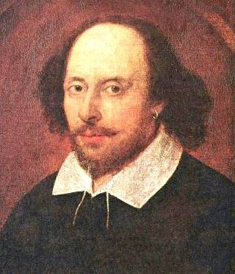
Guess who lived there……
William Shakespeare

Slide 3
What he did
He was widely regarded as the best ‘playwrite’ in the whole WORLD! He wrote poems too!

Slide 4
His plays
Hamlet
Romeo and Juliet
MacBeth
Comdy of Errors
Comedy of errors
King Lear
Much Ado About Nothing
and many many more…

Slide 5
Want to find out more?
. He married Anne Hathaway
. He was an actor too
. He had twins called Hamnet and Judith
. He had another daughter that was the eldest Susanna
. He began a successful career as an actor and play write
. He was a part owner of a playing company
. He retired to stratford around 1613 aged 4 9
. He died 3 years after he retired

Slide 6
MOMORE
MORE FACTS…
Legend has it that Shakespeare was born and died on the same day the 23rd April.
His parents were called John and Mary and he also had 4 sisters.
He was often called the ‘Bard of Avon’
Actors to this day consider saying the word Macbeth to be unlucky so they call it the Scottish play.
He wrote 37 plays, 154 sonnets and 4 poems.

Slide 7
Ready for a quiz?
Name two plays that he wrote:
Romeo and Juliet, McBeth, King Lear, Comedy of Errors, Much Ado About Nothing also Hamlet
Name one of his children
Hamnet
Judith
Susanna
Have u listened?

Slide 8
And more…..
True of false? Did William Shakespeare die 3 days after he retired?
False! he died 3 years after he retired
Did William write poems?
True! He wrote 4 poems and 154 sonnets
True or false? Did actors call Macbeth the Welsh play?
False! They called it the Scottish play

Slide 9
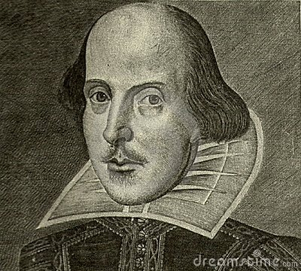
Thank you for watching my presentation. I hope you’ve learned a lot about William Shakespeare.
Any questions?

