Slide 1

My Great Briton!
By Emily Henderson

Slide 2
WELCOME!
HELLO AND WELCOME TO MY PRESENTATION ABOUT MY GREAT BRITION. MY GREAT BRITION IS A WELL KNOWN BY A CANCER FONDATION AND IS A GEORDIE SUPPORTER. AND MY GREAT BRITON IS...

Slide 3

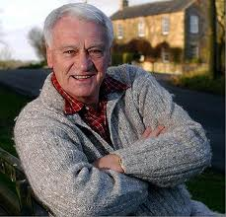

Slide 4
FACTS ABOUT HIM.
BOBBY ROBSON WAS BORN ON FEBRUARY 18TH 1933.
HIS SONS ARE CALLED ANDREW ROBSON , PAUL ROBSON AND MARK ROBSON
HIS WIFE IS CALLED ELSIE ROBSON
WHEN HE WAS DIAGNOSED WITH LUNG CANCER HE SET UP A FOUNDATION CALLED ‘THE BOBBY ROBSON FOUNDATION’
HE HAS HAD CANCER AN AMAZING 5 TIMES BUT SADLEY DIED FROM 1.
HE HAD LUNG CANCER 4 TIMES AND BRIAN CANCER ONCE. HE DIED FROM THE LUNG CANCER IN 2009.

Slide 5
BEING KIGHTED
BOBBY ROBSON WAS KIGHTED BY THE QUEEN IN JUNE 2002. THIS MEANS THAT HE WAS VERY IMPORTANT AND THE QUEEN ADMIRED WHAT HE DID. THERE HAS BEEN OTHER PEOPLE THAT HAVE BEEN KNIGHTED SUCH AS...
BRUCE FORSYTH
STEVEN REDGRAVE(A FAMOUS ROWER)
AND LOTS MORE!!!

Slide 6
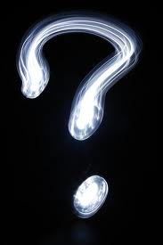
QUIZ TIME!

Slide 7
QUESTION 1.
WHAT ARE BOBBY ROBSON’S CHILDREN CALLED? IS IT...
BOB, LUKE AND CHARLES
MARK, ANDREW AND PAUL
KEVIN, JACK AND LEE

Slide 8
THE ANSWER IS...
BOB, LUKE AND CHARLES
MARK, ANDREW AND PAUL
KEVIN, JACK AND LEE

Slide 9
QUESTION 2.
WHAT IS HIS WIFE CALLED? IS IT..
A.ELINA ROBSON
B. ELSIA ROBSON
C. EMILY ROBSON
D. EMMA ROBSON

Slide 10
THE ANSWER IS ...
A.ELINA ROBSON
B. ELSIA ROBSON
C. EMILY ROBSON
D. EMMA ROBSON

Slide 11
QUESTION 3.
HOW MANY TIMES DID HE HAVE CANCER?...
5
4
6
3

Slide 12
QUESTION 3.
5
4
6
3

Slide 13
THANKYOU!
THANKYOU FOR WATCHING MY PRESENTATION. I HOPE YOU HAVE ENJOYED LISTNING IS I HAVE PRESENTING. AND WELL DONE TO OUR LUCKY WINNER!
THANKYOU!

