Slide 1
Rebecca Adlington
An inspiration to all!

Slide 2
Who is Rebecca Adlington?
Rebecca Adlington is an Olympic gold medallist swimmer.
She is the youngest of three sisters (Chloe and Laura) and learnt to swim at the age of 4, following in her sisters footsteps.

Slide 3
Progression to Competitive Swimming
Rebecca started swimming competitively for Sherwood Collery Swimming Club in Mansfield.
Taking part in relays from the age of 9 and at the age of 10, swimming individually.

Slide 4
Fact File
Rebecca was born 17.02.1989 (23 years old)
Her competitive spirit was forged trying desperately to keep up with her two older sisters.
She now swims for Nova Centurion Swimming Club in Nottinghamshire.
Bill Funiss is her coach

Slide 5
Achievements
Following her achievements in Beijing, Rebecca was awarded an OBE by her majesty the Queen in the New Years Honours of 2009.
She also came 3rd in the Sports Personality of the Year 2008 and was awarded the Laureus World Sports Awards 'Breakthrough of the Year Award' in 2009.

Slide 6
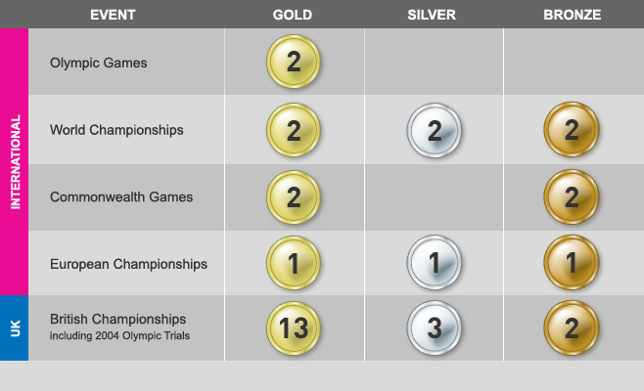
Medals

Slide 7
Are there any words or phrases anyone needs clarified?

Slide 8
Thank you for listening to my presentation on Rebecca Adlington, I hope you enjoyed it!

