Slide 1

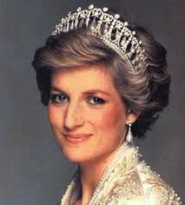
Princess Diana

Slide 2
Diana’s Family
Mother: Frances Shand Kydd.
Father : John Spencer.
Husband : Charles, Prince of Wales.
Children : Prince Harry and Prince William.

Slide 3
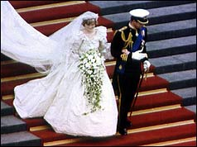
Important Events
June 1, 1961
Diana Frances Spencer born in Norfolk, England.
1980
On a visit to see her sister Jane, who was married to Robert Fellowes, an assistant secretary to the Queen, Diana and Charles met; soon, Charles asked Diana for a date.
February 3, 1981
Prince Charles proposed to Lady Diana Spencer at a dinner for two at Buckingham Palace
July 29 , 1981
wedding of Lady Diana Spencer and Charles, Prince of Wales, at St. Paul's Cathedral; broadcast worldwide

Slide 4
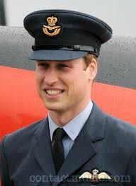
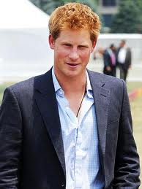
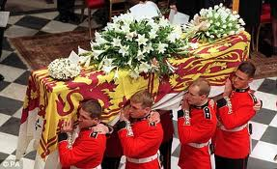
June 21, 1982
Prince William born (William Arthur Philip Louis)
September 15, 1984
Prince Harry born (Henry Charles Albert David)
December 9, 1992
formal announcement of the legal separation of Diana and Charles
February 29, 1996
Princess Diana announced she'd agreed to a divorce
August 31 , 1997
Diana, Princess of Wales, died of injuries sustained in a car accident, in Paris, France
September 6, 1997
Princess Diana's funeral. She was buried at the Spencer estate at Althorp, on an island in a lake

Slide 5
Princess Diana was patron of many charities here are just some charities...
Aids and leprosy.
The homeless and the elderly.
International Campaign to Ban Landmines.

Slide 6
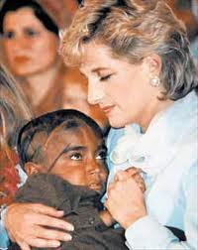
AIDS
Despite having donated financially, perhaps Diana's biggest contribution to AIDS charity work was her public persona. In 1987 there was still a lack of widespread education on how AIDS was contracted and many people believed that AIDS was contagious through casual contact. Diana however, was one of the first celebrities photographed touching and holding HIV/AIDS patients and many experts credit her with removing the stigma associated with AIDS.

Slide 7
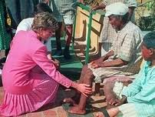
Leprosy
Diana, Princess of Wales brought the plight of leprosy-affected people to the world’s attention. She recognised that the stigma associated with leprosy was ill-founded and dispelled one of the myths surrounding it – that it can be passed on by touch – by visiting hospitals and touching patients.

Slide 8
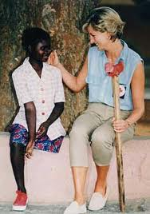
Landmines
During her final year Diana lent highly visible support to the international campaign to ban landmines, a campaign which won the Nobel peace prize in 1997, only a few months after her death. The campaign against anti-personnel landmines that remained hidden and deadly across wide areas of territory long after the conflicts ended .

Slide 9
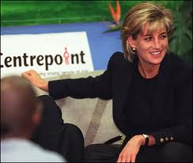
Diana supported Centrepoint the charity for people who are homeless...
The UK national charity working to improve the lives of socially excluded, homeless young people.

Slide 10
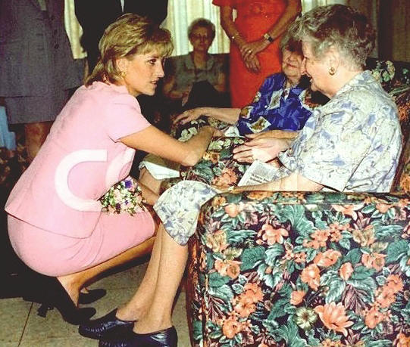
The elderly
An elderly home opened by Britain's Princess Diana in a Zimbabwe township during her African charity crusades has run out of money nearly two decades after its opening. Princess Diana went to see the elderly quite often.

Slide 11

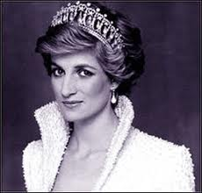
And this is why I think princess Diana was a GREAT BRITON!!!!!

