Slide 1
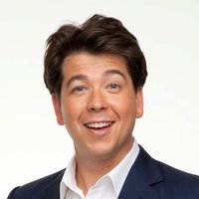
MICHAEL McIntyre
BORN 21st February 1976

Slide 2
CHILDHOOD
McIntyre was born in Merton, Southwest London, and raised in Hampstead.
His parents were both in show business, his Canadian father (Ray Cameron) was a writer for the Kenny Everett television show and his Hungarian mother (Kati) was a dancer.
His parents got a divorce when he was 7 and both remarried and had other children.
Ray Cameron relocated to Los Angles, where he died of a heart attack in 1993, aged 55.

Slide 3
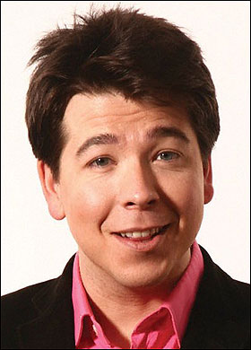
EDUCATION
McIntyre went to Arnold House Prep School and then attended Merchant Taylors School, Northwood for three years before transferring to local
state school Woodhouse College for financial reasons.
McIntyre later attended Edinburgh University for one year before dropping out to pursue a career in script writing. He has said that he cannot remember whether it was biology or chemistry that he studied while there.

Slide 4
CAREER
McIntyre has appeared three times on BBC One's Live at the Apollo and also on the Royal Variety Performance, in 2006, 2008 and 2010. While performing on stage in Wolverhampton in 2008, as he was running back onto stage for his encore, McIntyre tripped, fell over and dislocated his shoulder. Many of the audience believed this to be part of his act and started to laugh only after his manager came on stage to assist did they realise it was real.
In 2009, McIntyre performed for an estimated total of 500,000 people on his first tour of the United Kingdom that included a record-breaking six nights at Wembley Arena and four at The O2 Arena.
From 6 June 2009, McIntyre began hosting Michael McIntyre's Comedy Road show, aired on Saturday nights on BBC One.

Slide 5
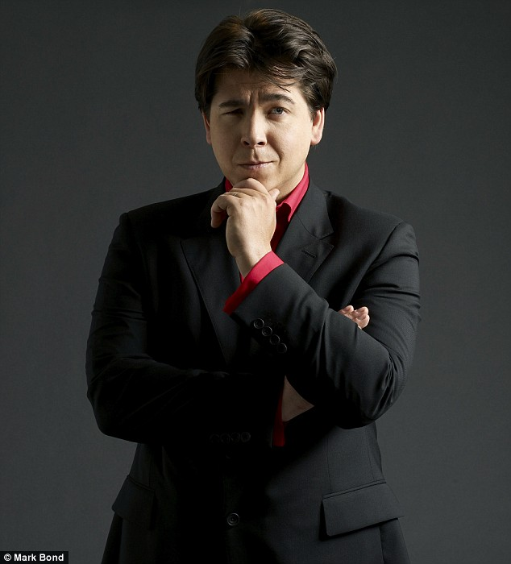
NOW A QUIZ

Slide 6
WHERE WAS MICHAEL BORN?
a) Newcastle Upon-Tyne
b) South London
c) Liverpool

Slide 7
THE ANSWER IS
b) South London

Slide 8
WHAT NATIONALITY WAS HIS FATHER ?
a) English
b) American
c) Canadian

Slide 9
THE ANSWER IS
C) Canadian

Slide 10
FINAL QUESTION
When was Michael born?
A) February 21st 1976
B) February 19th 1976
C) February 12th 1976

Slide 11
THE ANSWER IS
a) February 21st 1976

Slide 12
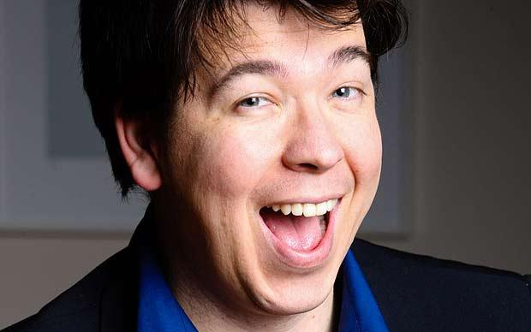
THE BEST COMEDIAN EVER

