Slide 1
Margot Fonteyn

Slide 2
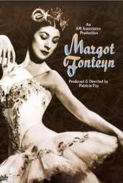
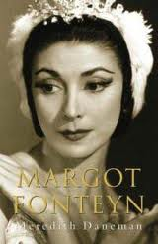
Are you wondering who Margot Fonteyn is? Well your in luck because this is your chance to find out…..

Slide 3
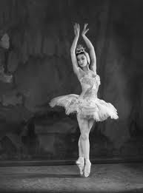
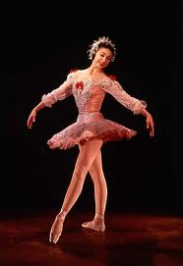
Introduction
Margot was born on the 18th May 1919, and was named Margaret Hookham. Her birthplace was Surrey, her father was English and her mother was Irish/Brazilian. She spent her entire career as a dancer in the Royal Ballet, eventually being appointed Prima Ballerina Assoluta of the company by HM Queen Elizabeth II.

Slide 4
Contents
Information about Margot’s life
Dancing with Rudolph and others
Relationships
Living the dream
How it all ended

Slide 5


Information about Margot’s life
Margot was one of the greatest ballet dancers of all time, she was in the award winning dancing show- Swan Lake. She was extremely talented, here are some of her main roles during her career:
Swan Lake The Dying Swan
Romeo and Juliet Sleeping Beauty
Giselle

Slide 6
Dancing with Rudolf and others
In the 1940s, she and Robert Helpmann (known as Rudolf Nureyev) formed a very successful dance partnership, and they toured together for several years. In the 1950s, she danced regularly with Michael Somes. In 1955, they danced together in the first ever colour telecast of a ballet, NBC's production of The Sleeping Beauty. In 1958 they appeared together in the first British televised version of The Nutcracker.

Slide 7
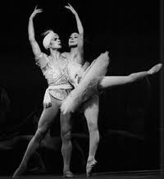
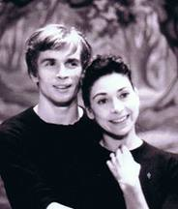
Rudolf and Margot

Slide 8
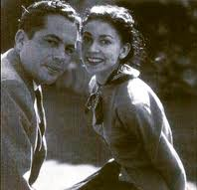
Relationships
During the late 1930s and early 1940s, Fonteyn had a long relationship with composer Constant Lambert. Lambert expressed some aspects of this in his ballet Horoscope (1938).
In 1955, Fonteyn married Dr. Roberto Arias.

Slide 9
Living the dream
Fonteyn was awarded a DBE (Dame Commander Of The British Empire) in 1956 at the age of 37.
She was chancellor of the University of Durham from 1981 to 1990. The main hall in Dunelm House, the Student Union building, is named the Fonteyn Ballroom in her honour.

Slide 10
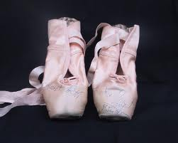
How it all ended
It all ended when Margot died, aged 71, in February 21st 1991.
It was a big miss to all of the ballet dancers in The Royal Ballet, and she is still a huge inspiration today.
As you can see Margot is
truly a GREAT BRITON.

