Slide 1
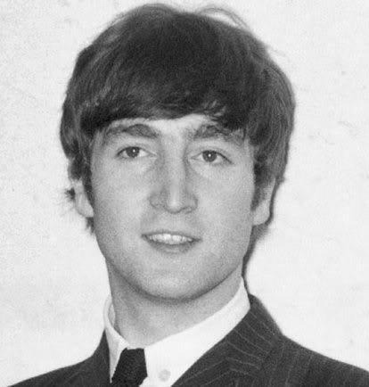
JOHN LENNON
John was a singer-songwriter from Liverpool, England.
He was the founder member of The Beatles.
In the band were Paul McCartney, George Harrison ,Ringo Starr and the man himself, John Lennon.

Slide 2
EARLY LIFE
John was born on 9th October 1940.
He enjoyed playing musical instruments and singing.
In 1956 he formed a band called The Quarrymen which went on to become The Beatles.

Slide 3
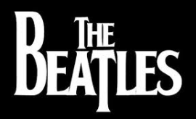
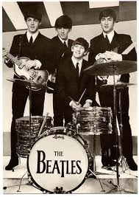
THE BEATLES
The Beatles were a big part of Johns life and made him into a star. In their early days they performed at the Cavern, Liverpool.
They produced and sold millions of records.
They recorded some of their Albums at the famous Abbey Road Studios (London). They were very famous all over the world, especially in America where they were greeted by thousands of screaming fans.
In 1970, The Beatles split up, this caused a lot of fans to be extremly upset.

Slide 4
SONGS BY THE BEATLES
Twist And Shout
Hard Days Night
Paper back Writer
Strawberry Fields

Slide 5
DEATH
John was shot dead on 8th December 1980, he was only 40 years of age.
He was shot as he left his apartment (the Dakota building) in New York. His death was a tragedy. Everybody who adored him were heartbroken they said ‘when he died it was as if a little piece of me died’.

Slide 6
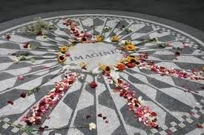
STRAWBERRY FIELDS
Strawberry field’s is a remembrance garden for John Lennon in Central Park, New York. There is a famous mosaic, which represents his famous song “Imagine”. A lot of tourist go to New York to visit this famous garden.

Slide 7
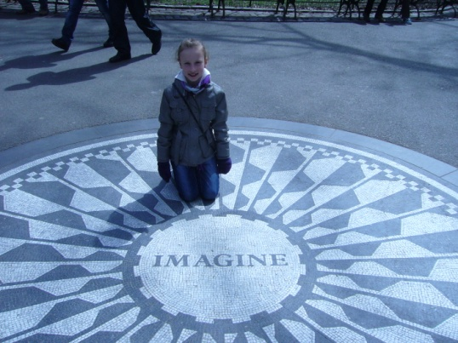
Thank you for watching!

