Slide 1
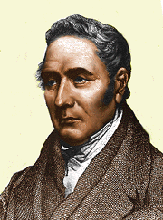
George Stephenson
Why he is a GREAT Britain

Slide 2
Early Life
George Stephenson was born in Wylam, Northumberland, 9.3 miles (15.0 km) west of Newcastle Upon a Tyne. He was the second child of Robert and Mabel, neither of whom could read or write. Robert was the fireman for Wylam Colliery pumping engine, earning a very low wage, so that there was no money for schooling. At 17, Stephenson became an engineman at Water Row Pit,Newbur. George realised the value of education and paid to study at night school to learn reading, writing and arithmetic—he was illiterate till the age of 18. In 1801 he began work at Black Callerton colliery as a 'brakesman', controlling the winding gear of the pit. In 1802 he married Frances (Fanny) Henderson and moved to Willington Quay, east of Newcastle. There he worked as a brakesman while they lived in one room of a cottage. George made shoes and mended clocks to supplement his income.

Slide 3
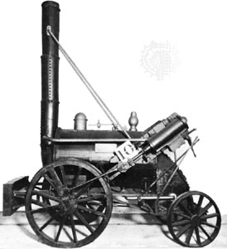
The Rocket
Stephenson's Rocket was an early steam locomotive of 0-2 2wheel arrangement, built in 1829 at the Forth Street Works of Robert Stephenson and Company in Newcastle Upon Tyne.
It was built for, and won, the Rain hill trials held by the Liverpool and Manchester railway in 1829 to choose the best design to power the railway.
Though the Rocket was not the first steam locomotive, it was the first to bring together several innovations to produce the most advanced locomotive of its day.
It is the most famous example of an evolving design of locomotives by Stephenson that became the template for most steam engines in the following 150 years.

Slide 4
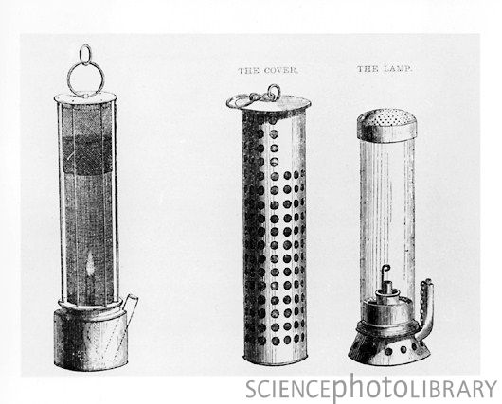
The Safety Lamp
In 1815, aware of the explosions often caused in mines by naked flames, Stephenson began to experiment with a safety lampthat would burn without causing an explosion. At the same time, Cornishman Sir Humphrey Davey, the eminent scientist was also looking at the problem. Despite his lack of any scientific knowledge, Stephenson, by trial and error, devised a lamp in which the air entered via tiny holes. Stephenson demonstrated the lamp himself to two witnesses by taking it down Killingworth colliery and holding it directly in front of a fissure from which fire damp was issuing. This was a month before Davy presented his design to the Royal society. The two designs differed in that, the Davy's lamp was surrounded by a screen of gauze, whereas Stephenson's lamp was contained in a glass cylinder. For his invention Davy was awarded £2,000, whilst Stephenson was accused of stealing the idea from Davy

