Slide 1
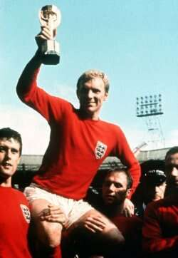
who was one of the most amazing brits ever?.....
Bobby Moore!!!!!!!

Slide 2
Bobby Moore`s main facts/events
.Born 12th April 1941
.full name Robert Frederick Chelsea Moore
.Signs amateur for West Ham August 1956
.England youth team debut October 2nd 1957
.signs professional for West Ham May 1958
.Debut for West Ham first team September 8th 1958 ( vs. Manchester United)
.Debut for England under 23`s 2nd November 1960
.First game as West Ham captain 20th April 1962(vs. Cardiff City)
.Debut for England first team 20th May 1962 ( vs. Peru)
.Marries Tina Dean June 30th 1962
.Captains England for first time 20th May 1963
.Won footballer of the year award in 1964
.Captains England to world cup final over West Germany July 30th 1966
.Awarded O.B.E January 1st 1967
.Died 24th February 1993 at the age of 51.

Slide 3
ADDED EXTRA’S
England Appearances
England Caps: 108 - 90 as Captain.
He also played for USA alongside the world famous Pele and the opponents were ENGLAND!
He was the first Englishman to lift the world cup in 1966.
In 1981 he starred in a famous film about football in World War 2, again alongside Pele called Escape to Victory.
He was wrongly accused of stealing a bracelet from a jeweller in Columbia.

Slide 4

QUIZ TIME!!!!!!!!!!!!!!!!!!!!!!!!!!!
1.How old was Bobby when he died? 51
2.What was Bobby blamed for stealing? Bracelet
3.In which year did he lift the world cup? 1966
4.In which month did he sign amateur? May
5.True or false? he married Tina Deam. false

