Slide 1

My GREAT Briton
Is…

Slide 2
Beatrix
Potter

Slide 3
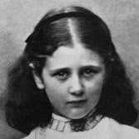
CHILDHOOD
Helen Beatrix Potter was born on the 28th July 1866 at Number 2, Bolton Gardens, Kensington, in London. The Potters were a typical Victorian family, living in a large house with servants. Beatrix was looked after by a nanny, spending most of her time in the big nursery at the top of the house and often only seeing her parents at bedtime.
Beatrix’s parents didn’t give her many opportunities to mix with other children but they were tolerant of the animals in the schoolroom. They also encouraged her interest in art, providing her with special art tutors and taking her to see exhibitions at galleries.

Slide 4
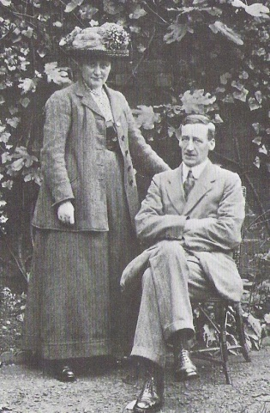
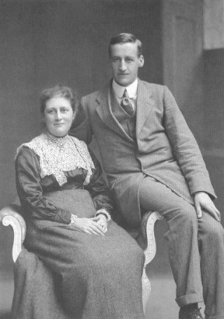
In her early 20s , Beatrix's parents tried to arrange a suitable partner for Beatrix to marry. Many suitable men were found , however for each suitable partnership Beatrix turned them down . She was a very independent women, and disliked the idea of staying at home and bringing up children. For the late Victorian time period Beatrix remained single and stayed at home.
Beatrix’s started a relationship with a man called Norman Warne the relationship was going really well and they soon became engaged. However, Beatrix’s parents disapproved of this marriage they did not like the idea of Beatrix being married to a tradesman. Her parents decided to give Beatrix 6 months so she could change her mind. But before they could even have the wedding Norman passed away, dyeing of anaemia. Beatrix was devastated. She decided to write a letter to her sister-Millie- saying; “He did not live long, but he fulfilled a useful happy life. I must try to make a fresh beginning next year.”

Slide 5
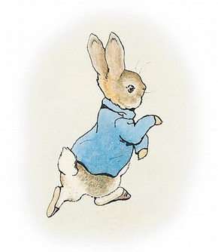
How she became a children's writer?
Her love of the countryside stemmed from her childhood holidays in the Lake District. In the 19th Century, there was no formal education for girls and Victorian values also forbid her to become a farmer. When Beatrix was young she had various animals as pets, which she made drawings of, whilst watching them. During the summer months she would go to Scotland with her parents for a 3 month holiday. When she was [16] they could not go to Scotland because the house they usually rented was not available. Therefore, her parents decided to go to the Lake District and stayed at a luxury hotel near Ambleside.
Beatrix became friends with one of the Vicars in the Lake district he was called Cannon H, he encouraged Beatrix to publish her first book ‘The Tail of Peter Rabbit ‘

Slide 6
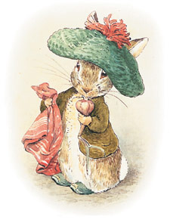
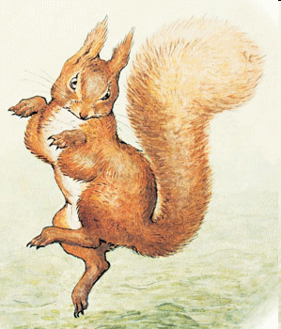
The book was to be "The Tale of Peter Rabbit" and was sent to Frederick Warne, a well known publisher of children's books. But it was returned, and many other publishers also rejected it. In 1901 she found a printer herself and she produced 250 copies of the book for a cost of £11. The books were then sold to doting aunts and uncles for their nephews, nieces and to friends for a price of 1s 2d. They sold well and more were produced. Also, another book was brought out, named "The Tailor of Gloucester" in 1902. In this year, Frederick Warne contacted Beatrix and said they would publish "The Tale of Peter Rabbit" if it could be published in colour. Then several books followed-"The Tale of Squirrel Nutkin" and "The Tale of Benjamin Bunny".

Slide 7
A big percentage of the Lake District was bought by Beatrix Potter, developers arrived to start building houses on the lake District. Beatrix was so appalled she bought the land and When she died she left 4000 acres and 14 farms to the national trust, it was her gift to the nation so everyone could enjoy her beloved countryside.
Beatrix died at the age of 77 on the 22nd December 1943.

Slide 8
HERE ARE SOME OF THE BOOKS SHE HAS WROTE
THE TALE OF MR. JEREMY FISHER
THE TALE OF BENJAMIN BUNNY
THE TALE OF TWO BAD MICE
THE TALE OF MRS. TIGGY-WINKLE
THE TALE OF PETER RABBIT
THE TAILOR OF THE GLOUCESTER
THE TALE OF THE SQUIRREL NUTKIN
THE TALE OF THE FLOPSY BUNNIES
THE TALE OF JEMIMA PUDDLEDUCK
THE TALE OF TOM KITTEN

Slide 9

Thank you for listening.

